Slide 1
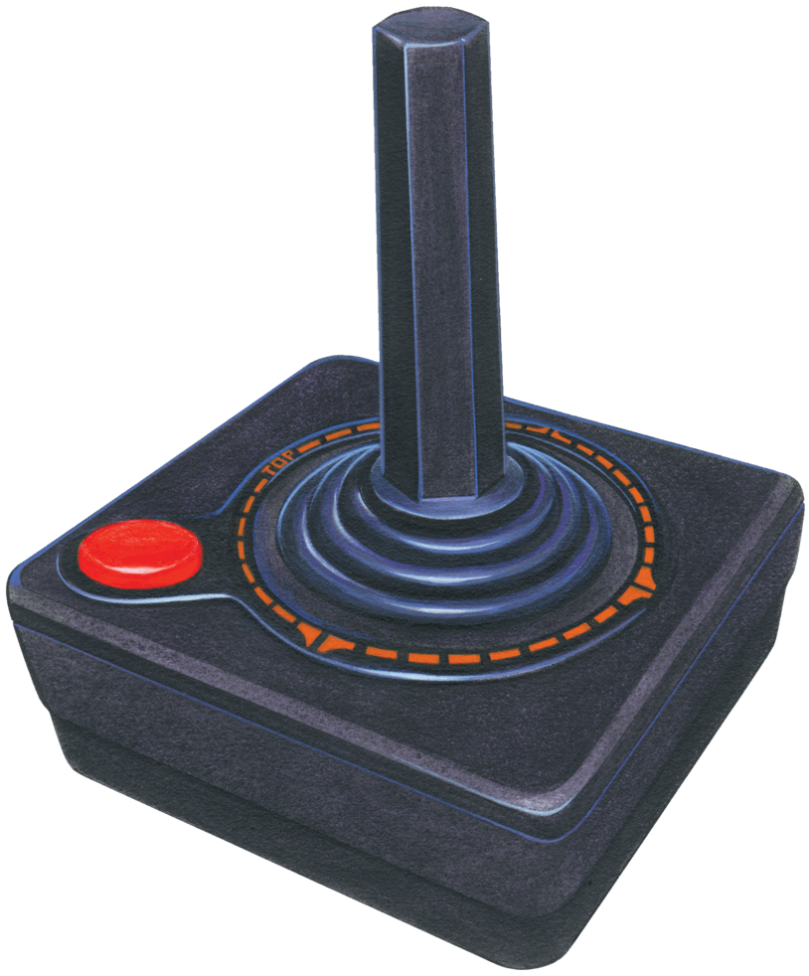
Characters Behaviors in Video game Using Reinforcement Learning

Slide 2
What is Reinforcement Learning?

Slide 3
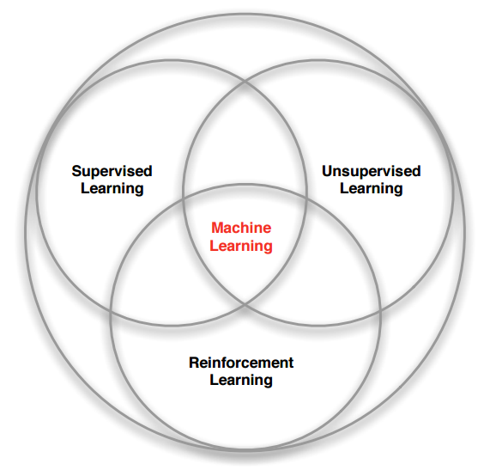
Reinforcement Learning (RL) is a one part of Machine Learning that about Trial-and-Error
That Inspire by concept of Behavioral Psychology

Slide 4
Basic Concept of Reinforcement Learning

Slide 5
Give me a hand. Good!
Give me hand. Ouch!!!!
Reward (Positive Reward)
Punishment (Negative Reward)

Slide 6
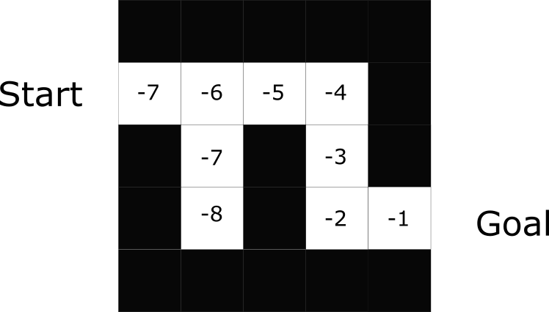
Situation : Find a Way to get out of the maze
Positive Reward : Go to Right way. You get +1 for each step
Negative Reward : Go to Wrong way. You get -1 for each step

Slide 7
Objective : Find the best way to do an optimal action to get a most reward or achieve goals

Slide 8
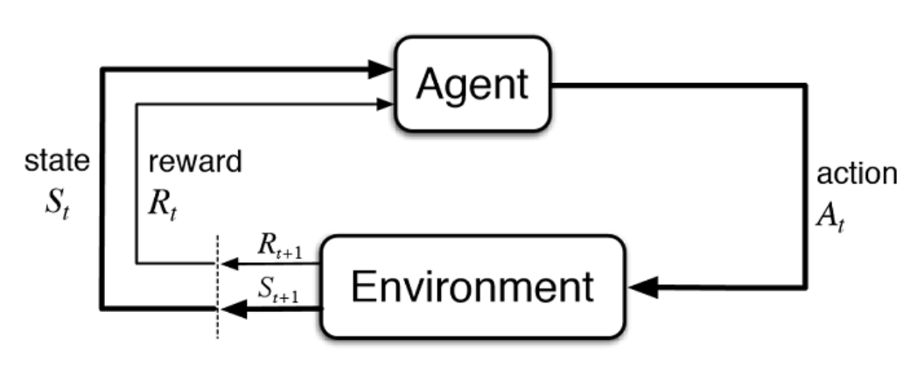
Reinforcement Learning Cycle

Slide 9
Reinforcement Learning Tools

Slide 10
Gym : toolkit for developing and comparing reinforcement learning algorithms

Slide 11
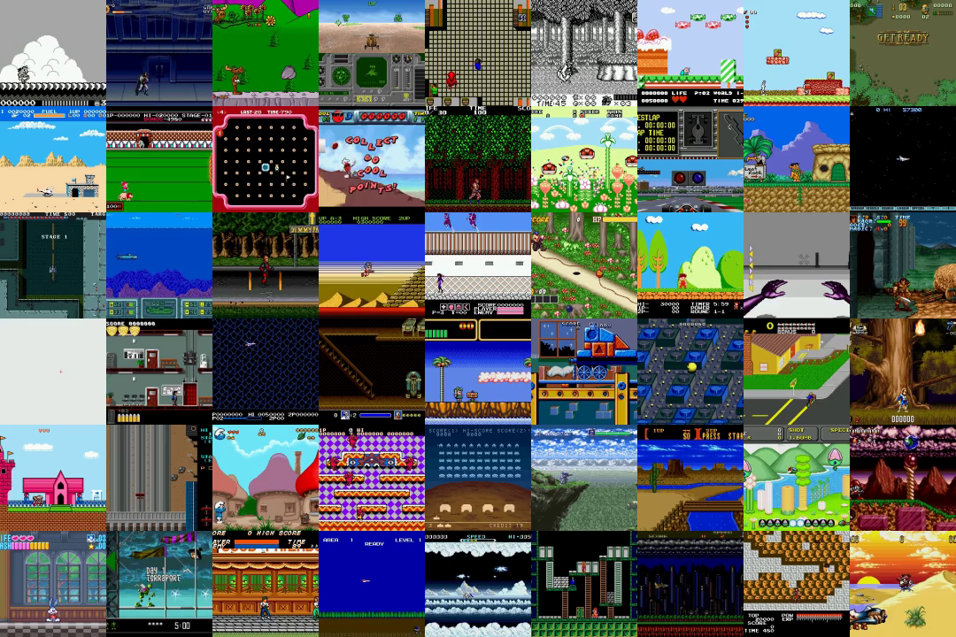
Gym Retro: turns classic video games into Gym environments for reinforcement learning

Slide 12

TensorFlow:
end-to-end open source platform for machine learning

Slide 13
Our
Works

Slide 14
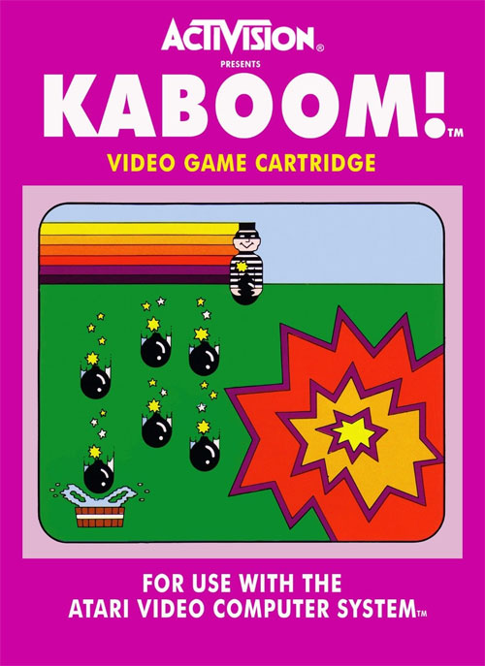
Performance Comparison of Reinforcement Learning Algorithm with Atari Game “Kaboom”

Slide 15
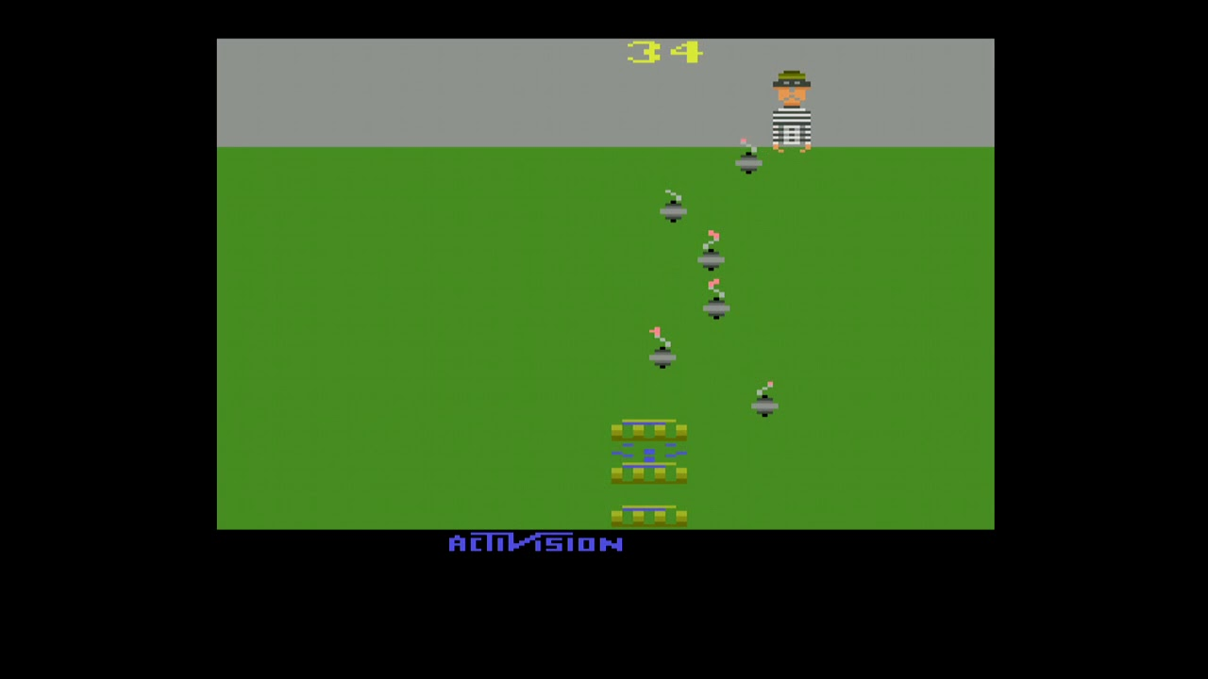
How to Play
Controls : Left, Right, Button
Rules : Receive a Bomb got a score. If miss lose one life (3 lives per games)
Goal : Get High Score or get 10,000 or above point to get Easter Egg

Slide 16
Kaboom Reinforcement Learning Cycle
State : Each Frame of Game
Action
Left, Right, Button
Environment
Kaboom Atari 2600 game
Positive Reward : if player catch a bomb. Get scores
Negative Reward : If player miss catching. Lose 1 Life

Slide 17
Structure

Slide 18

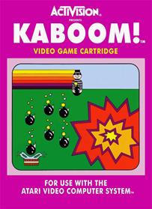
Kaboom Rom File :
Kaboom! (Paddle) (CCE).bin
retro_make
Library Require: Gym-Retro
Kaboom Environment
Environment Structure : Create Environment

Slide 19
Kaboom Environment
Action Space : MultiBinary(8)
Discretizer.py
Library Require: Gym
Kaboom Environment
Action Space : Discrete(3)
[Left], [Right], [Button]
Environment Structure : Get specific actions

Slide 20
Kaboom Environment
with Discrete Actions.
Observation: Box (210, 160, 3)
KaboomWrapper.py
(Python file for Wrapped Environment into Convolutional Neural Net)
Kaboom Environment
Observation: Box (4,84,84)
Environment Structure : Wrapper for CNN

Slide 21
Algorithm

Slide 22
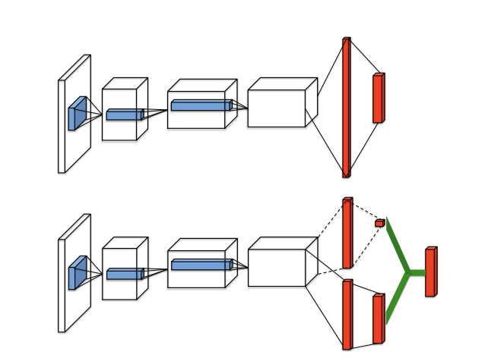
Dueling Deep Q Networks (DDQN)
อธิบาย ddqn

Slide 23
Why we use this DDQN?

Slide 24
Expect result

Slide 25
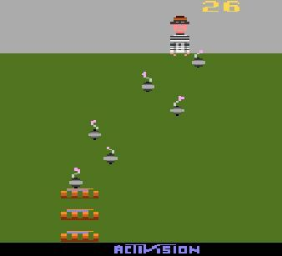
สิ่งที่เราคาดหวังที่จะได้รับจากการศึกษา และทดลองคือคอมพิวเตอร์มีความสามารถในการเล่นเกม Kaboom ได้อย่างมีประสิทธิภาพที่สุด โดยในการเล่นนั้นเราคาดหวังที่จะให้ปัญญาประดิษฐ์เล่นให้ได้

Slide 26
Result training

Slide 27
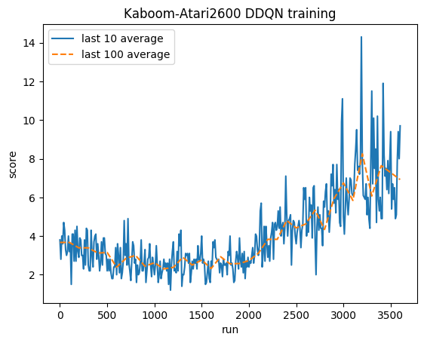

Slide 28
Conclusion

